Slide 1
Water Storage Tanks
Hydraulic Modeling and Water Quality Considerations
Justine Carroll, P.E.
Project Manager

Slide 2
Outline
Water age evaluation using EPS
Tank mixing and turnover
Case Study – Maple Street Tank, Paxton

Slide 3

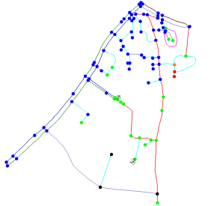
Hydraulic
Modeling
Notes:
Change picture here to be a model

Slide 4
Steady State
Pipe, tank, pump data used in model
Demands distributed to reflect usage
Verified using flow testing results
Steady state models used for the following:
  Identify pressure and fire flow deficiencies
  Evaluate proposed sub-divisions
  Evaluate hydraulic improvements
Notes:
Most models are steady state

Slide 5
Extended Period Simulations
Account for changes over time to operational conditions and demand variations
Used for the following:
  Refine recommendations
  Simulate water quality
  Improve planning and operation
Notes:
Water quality can look at water age, source/contaminant tracing (what percentage of water at a particular location is from a particular source) this shows blending over time. Can also tract a contaminate either from a source or from a tank. Also, can considered growth and decay of chemical or biological constituents (this includes chlorine).

Slide 6
Pump Controls
Pump | Water Level Pump On (ft) | Water Level Pump Off (ft)
Pump No. 1 | 30 | 40
Pump No. 2 | 27 | 37
Pump No. 3 | 20 | 30
Pump | Time Pump On | Time Pump Off
Well No. 1 | 7:00 am | 10:00 am
Well No. 2 | 7:00 pm | 7:00 am

Slide 7
Demand Patterns

Slide 8
EPS Verification
Notes:
Zero is midnight. Talk about the lower demands overnight that the levels mimic the demand patterns. Demands highest in mid morning and early evening. Also see where the pumps come on and off.

Slide 9
Water Quality Modeling
Constituent Tracking
  Tracks contamination from a particular source
  Predicts areas of influence and affected customers
Chlorine Levels
  Predicts chlorine levels in distribution system
  Considers decay rate from source water and decay from pipe walls
Notes:
Detecting chlorine levels in the system involves extensive data collection. Need to do bottle tests at the source to determine the chlorine decay rate from your source water
Then need to get chlorine level measurements throughout the distribution system to determine the decay rate from the pipe walls
To do the growth/decay modeling requires intensive data collection on source water decay rates and distribution system decay rates. This is more difficult to model. Water age is typically used as a measure of the overall water quality. Typically areas with older water will have lower chlorine residuals, etc.

Slide 10
Water Age
Time spent in the system
Source water age is zero
Older water can lead to water quality problems
Causes of high water ages include the following:
  Low demands
  System extremities
  Water storage tanks
Notes:
Water quality issues include high disinfection byproducts, low chlorine residual, system that do not need to chlorinate there is more of a chance for bacteria to develop
Large water mains serving only a few customers can cause the water in the pipe to stay in the pipes for long periods of time
Water storage tanks typically the main contributed to high water ages especially if they are oversized. Historically the opinion was bigger is better. The extent of the water age in tanks depends on mixing, turnover rates, inlet/outlet piping, hydraulics, size
After this slide go to the model to show water age, controls, results graphs

Slide 11

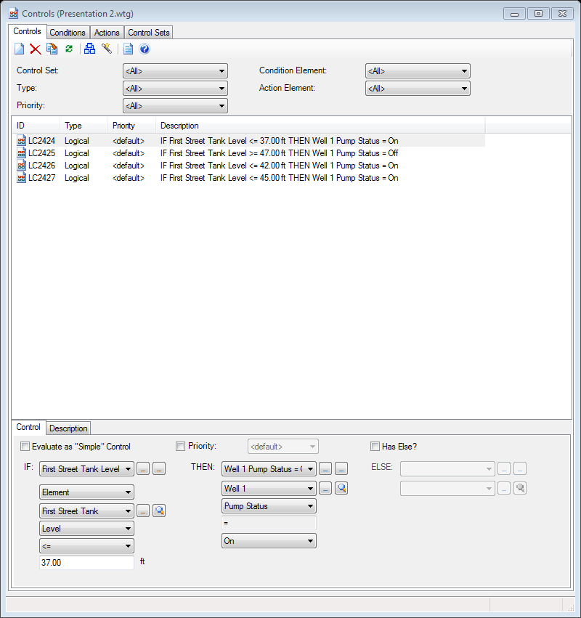
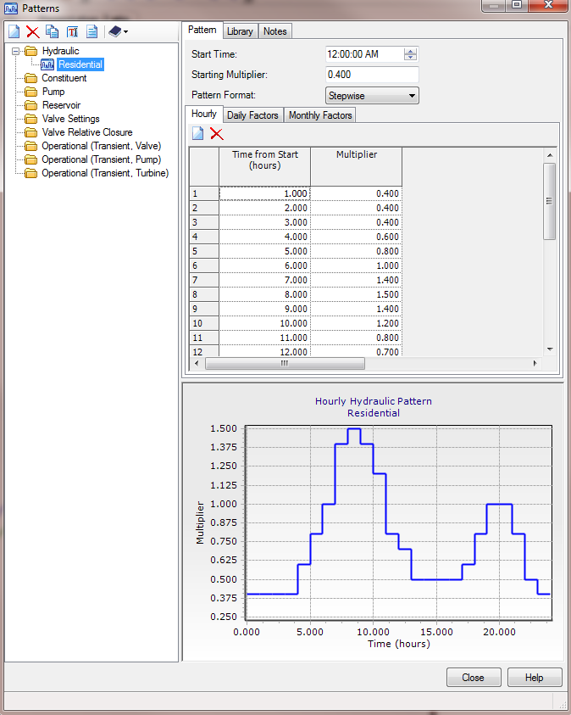
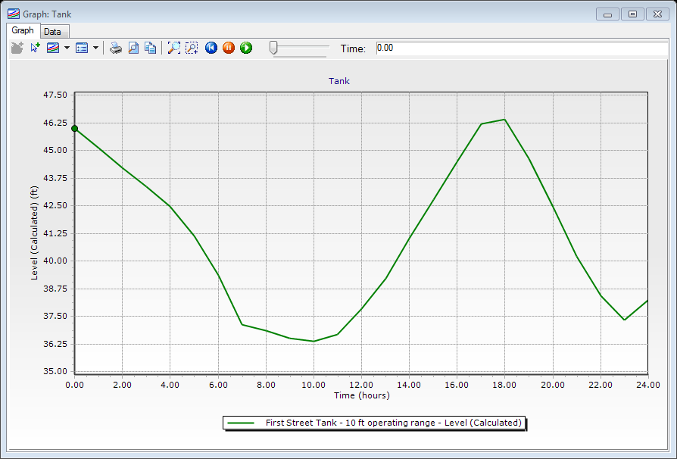
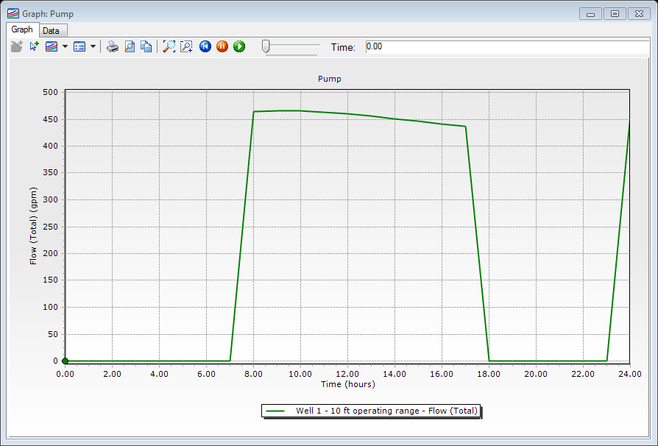
Notes:
Use Paxton model to show how demand patterns set up, controls inputted, and how water age is newest by source and oldest at tanks and extremities.

Slide 12
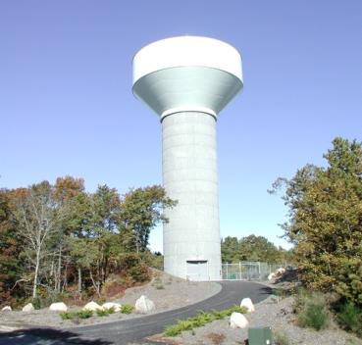
Tank Mixing and Turnover
Notes:
Change picture here to be a model

Slide 13
Tank Mixing
Tank geometry
Inlet diameter
Inlet/outlet location
Water temperature
Fill rate
Without proper mixing tank can experience short circuiting or stratification
Notes:
Fluid dynamics modeling techniques used to look at mixing.
Inlet diameter effects velocity and jetting action.
When the inlet outlet are same pipe may influence the minimum diameter
When inlet/outlet are separate, reduces the risk of short circuiting

Slide 14
Tank Mixing

Slide 15
Improving Tank Mixing
Changing size of inlet pipe
Separating inlet/outlet
Mixing system
Increasing operational range
Notes:
Separating inlet/outlet can be considered for new tank, not feasible for existing tank
Changing the size of the inlet/outlet pipe will vary in cost and ease of construction same with installation of a mixing system. They would have a cost and some would require the tank to be empty to install.
Changing the operational range has little to know cost. The ability to change the operational range depends on
Mention different types of mixing systems passive/active.

Slide 16
Tank Operating Parameters
  Maintain minimum working pressure 35 psi
  Maintain minimum pressure of 20 psi during fire
  Maintain normal working pressures 60-80 psi
  Maximum pressure without PRVs of 100 psi
  3-5 day turnover rate (20 to 30% volume per day)
  High and low variation less than 30 feet
Notes:
Based on MassDEP Guidelines
Pressure fluctuation at varying tank levels will also depend on system demands. Headloss in system under peak hour may cause more than a 4 psi difference.

Slide 17
Tank Turnover
Turnover rate depends on operating range and demands
0.5 mg tank, 50 ft high, 40 ft diameter
  5 ft operating range = 10% turnover
  10 ft operating range = 20% turnover
Notes:
Operating ranges would include one complete cycle per day.
Go to simplistic model to show how this would affect water age

Slide 18
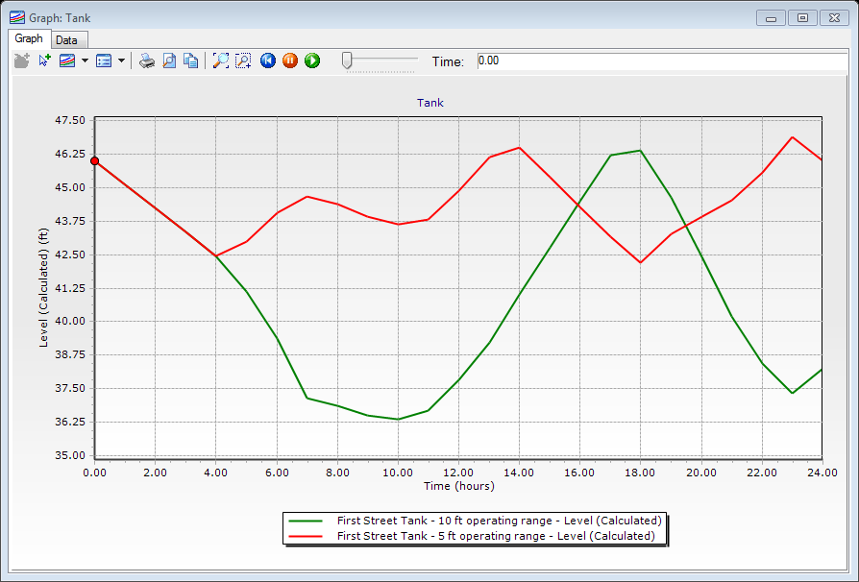
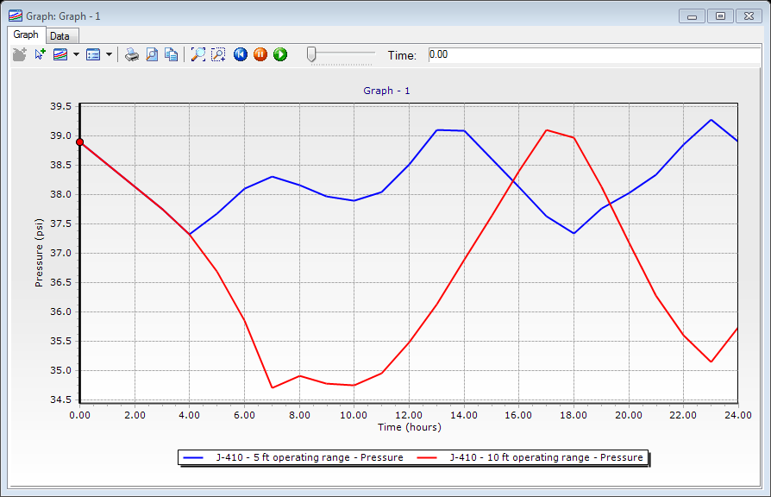
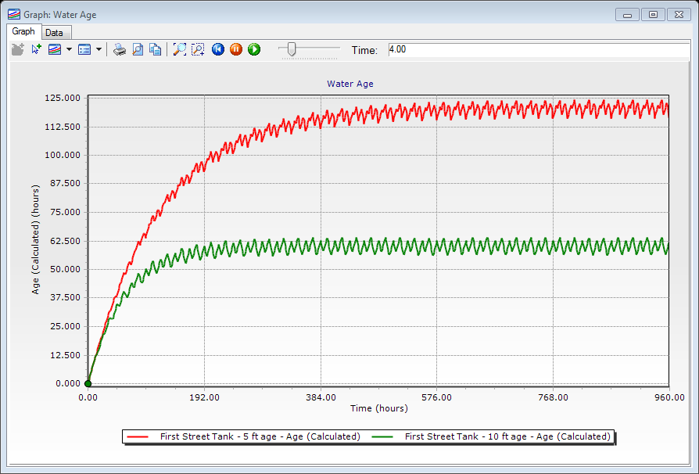
Notes:
Use presentation 2 model to demonstrate effect changing the operating range of the tank effects water age.
show screen shots with pressures and water age under two different operating conditions.

Slide 19
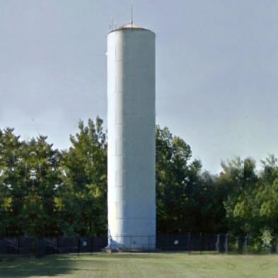
Case Study: Maple Street Tank
Paxton, MA
Notes:
Change picture here to be a model

Slide 20
Paxton, Massachusetts
Average Daily Demand - 0.3 mgd
Maximum Daily Demand - 0.7 mgd
Population Served – 3,680
All water purchased from Worcester
33 miles of main
Total Storage - 1.36 mg (two tanks)
Notes:
Water purchased from Worcester is pumped – pump station has two pumps and an emergency generator.
2006 WDS has 2025 required storage of 0.34 mg based on equalization of 0.16 mg and a basic fire flow of 1,500 gpm for 2 hrs. Emergency component was waived.
Talk about worcester system – surface water. Paxton is a consecutive system and has to maintain a residual throughout the system. They were having problems maintaining residual at extremities.

Slide 21
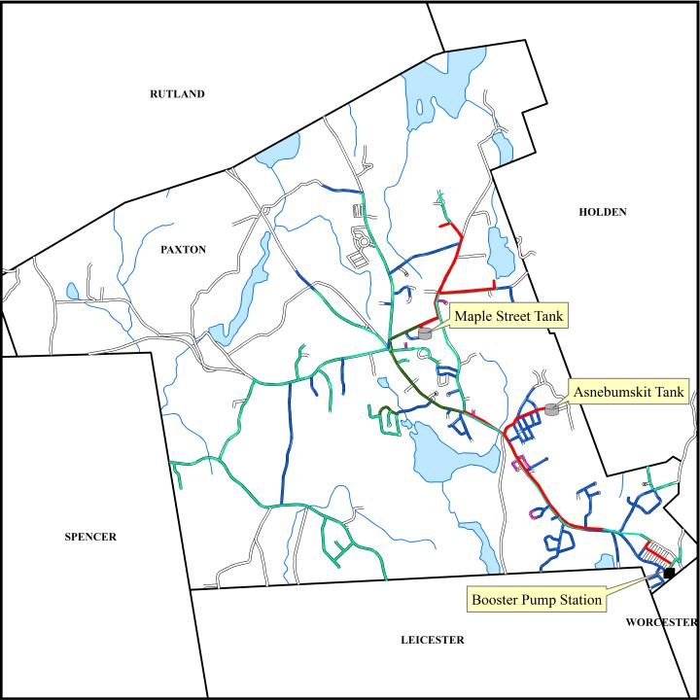
Notes:
Water comes from worcester. Controls for Paxton based on water levels in the Asnebumskit Tank, which is the closer of the two to the supply.

Slide 22
Asnebumskit Tank
Constructed in 1974
Prestressed Concrete Tank
Height – 40 feet
Diameter – 65 feet
Volume – 1.0 mg

Slide 23
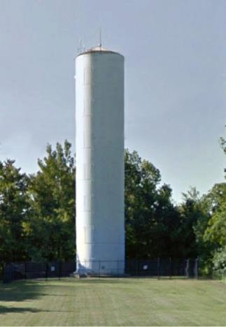
Existing Maple Street Tank
Constructed in 1934
Welded steel
Height – 100 feet
Diameter – 25 feet
Volume – 0.36 mg
Rehab costs - $300,000
Notes:
2010 tank inspection called for $300,000 in repairs, Repairs include: sandblasting and painting interior of tank, new ladders, repairs to roof hatch, vent, and overflow, new cathodic projection system.

Slide 24
Maple Street Tank Deficiencies
Unusable storage
High water age
Low chlorine residual
Repairs

Slide 25
Current Estimated Water Age
Notes:
Age in Maple Street approx. 30-31 days old
Age in Asnebumskit Tank approximately 12-13 days

Slide 26
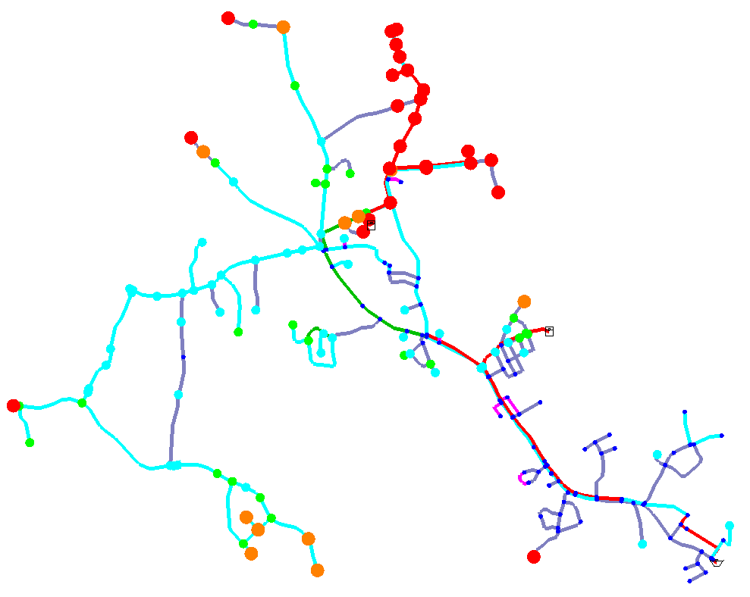
Notes:
They aren’t having DBP problems. The issue is maintaining the chlorine residual.

Slide 27
Chlorine
Performed jar tests at pump station
Took 14 chlorine samples at 12 locations
0.5 mg/L residual from Asnebumskit Tank
0.05 mg/L residual from Maple Street Tank

Slide 28
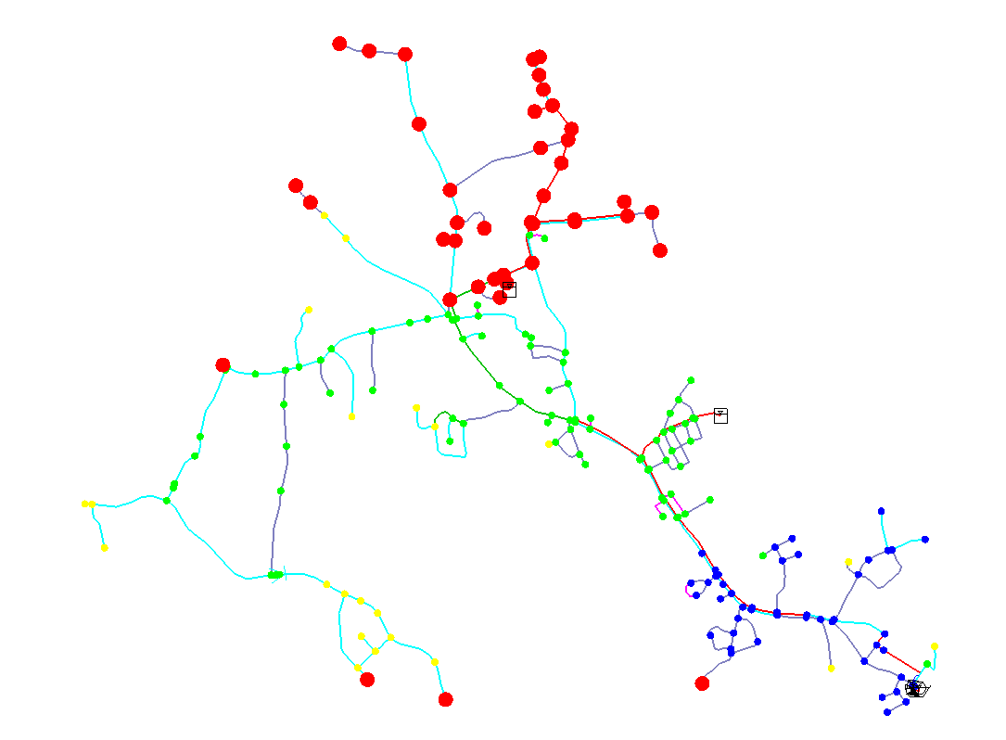
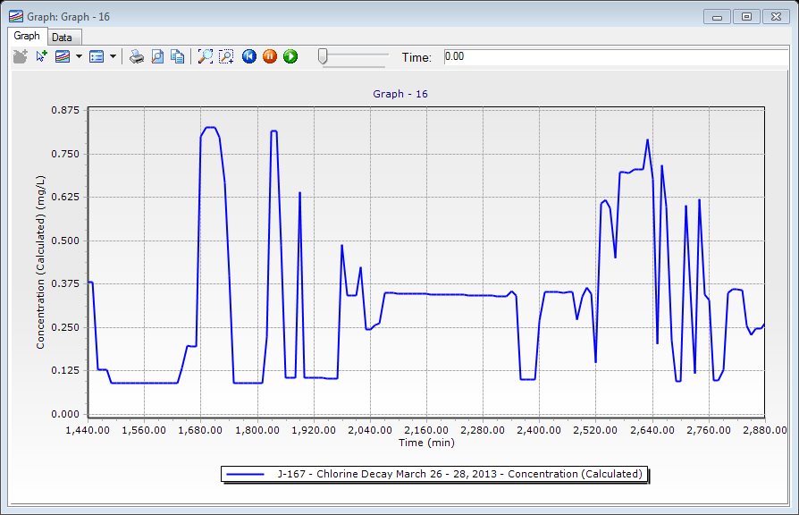

Slide 29
Recommendations and Benefits
Smaller elevated storage tank
Provides fire protection
Redundant storage location
Maintains pressures
Reduces water age
More useful water storage
Notes:
Recommendations from an Extended Period Simulation and Water Quality Study
Based on the study they do not need the storage, but the tank helped maintain pressures on that side of the system and provide fire protection in the anna maria colleage area.
Study verified the model under EPS, water age and water quality (chlorine residuals) were looked at. Alternative solutions included modifying the operation

Slide 30
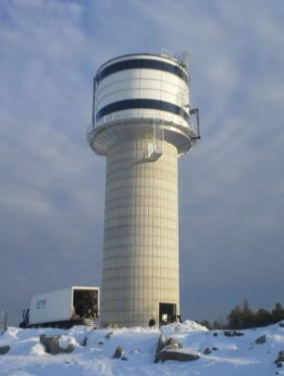
Proposed Maple Street Tank
Glass fused steel
Tank height – 38 feet
Total height – 100 feet
Volume – 0.20 mg
Chlorine booster pump
Active mixing system
Same site as existing tank
Notes:
Chlorine pump for emergencies to get the residuals to the extermities.

Slide 31
Maple Street Tank Water Age
Notes:
Age in existing Maple Street approx. 30-31 days old
Age in proposed tank approximately 12-13 days

Slide 32
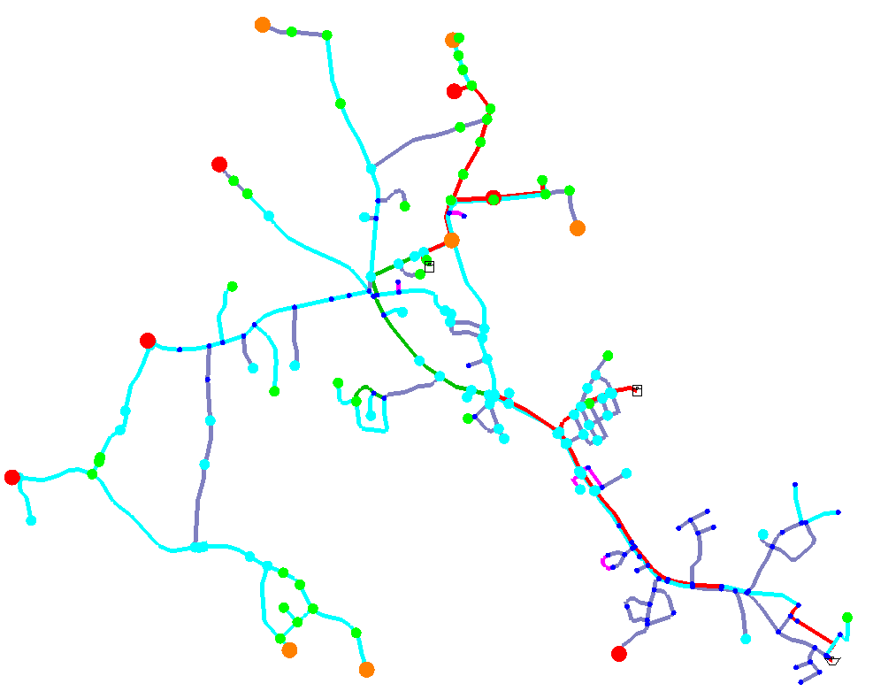
Notes:
Extremities sill have issues but overall the system water age will be improved with the new tank.

Slide 33
Schedule
Design/permitting – Ongoing
MassDEP filing/review – October 2014
Advertising – November 2014
Award contract – January 2015
Construction – Spring to Fall 2015
Tank demolition – December 2015

Slide 34
Questions? contact@tataandhoward.com
800-366-5760

